Slide 1
College of Arts, Media and Technology of Chiang Mai University 清迈大学艺术，传媒与技术学院
China Intelligence Center (CIC)
中国商务智能中心

Slide 2
Mission
Providing the Consultation , Marketing strategy plan;
Developing Chinese language PR(Public Relationship) for Local enterprises online marketing and research ;
Sharing important marketing information for the enterprises which aim to create the Thai enterprises competency in business.
To help the enterprises to contact the Chinese online marketing platform.
Tourism industry
Logistic industry
Cross Border E-commerce
others that about the business and investment

Slide 3
使命
提供商业咨询;
给当地企业的网络营销提供中文的 PR(公关)；
为泰国企业分享重商业信息，提高企业竞争力；
帮助企业恰接中国的网络营销平台
旅游业
物流行业
跨境电商
其它业务和投资

Slide 4
The Center provides the Service based on “3K”
Knowledge Worker:
There are over 30 knowledge management graduate students who follow the college lectures’ guidelines to as a knowledge worker practice group providing business consultant service.
Knowledge Connection:
There is a team to develop the PR contents and contact network of online marketing channels with China.
Knowledge Creation (From demand side):
Software Application to support Marketing 4.0.

Slide 5
中心基于“3K” 提供服务服务
知识工作者（ Knowledge Worker ）
30多个知识管理在读研究生再导师指导下作为一个知识工作者实践小组为客户提供商务咨询服务；
知识链接 （Knowledge Connection）
有专业团队为商户提供打开中国时长的网络营销PR内容和渠道；
基于需求的知识创造（Knowledge Creation)
市场营销4.0 的应用程序

Slide 6
Service of CIC
We provide the consultation for the online marketing channels which includes a platform to create or choose the related channels (such as, applications). We also provide the PR of products and the services for the organizations that focus on the Chinese target group in hospitality industry.
The catering industry (restaurant).
Travel souvenir shops.
Public transportation companies which can provide travel transportation Services.
Travel destinations.
SME who wants to export the products to China by online or trade fairs in China market.
Develop the Chinese language services for communication during distributing the products through various channel.
Provide Chinese market research.

Slide 7
CIC的服务
提供网络营销咨询服务，包括相关渠道的平台搭建，为致力于把中国人作为目标消费群体的企业提供产品和服务的PR。
餐饮业
旅游纪念品店
公共交通运输公司/企业
旅行目的地
想要把产品出口到中国或去中国做会展的企业
为产品多了网络营销渠道提供中文PR服务
中国的市场调研

Slide 8
The CIC program’s plan as follows
This year
Hai Tao Cross Border E-commerce from Thailand to China.
One day trip : the Travel experiences perspective from Chinese tourists.
Hop on Hop off tours company Travel trip routes design for Chinese tourists.
The popular Local Thai food for the Chinese.
The popular hotel style for Chinese.
Building the brand by “Offline to Online”
Next year
User Generated Content：to develop the travel trip routes depending on the tourists’ demands.
To create the value of Thai products during the Thailand traditional festivals and the important festivals of China.
To develop the PR activities for the tourism and premium products through Net Idol China
To find the key success factors of Thai products in China market.
To analysis the value of Thai Products in terms of the price for Chinese.
Chinese travel language and MICE(Meetings, Incentives, Conferences, and Events )

Slide 9
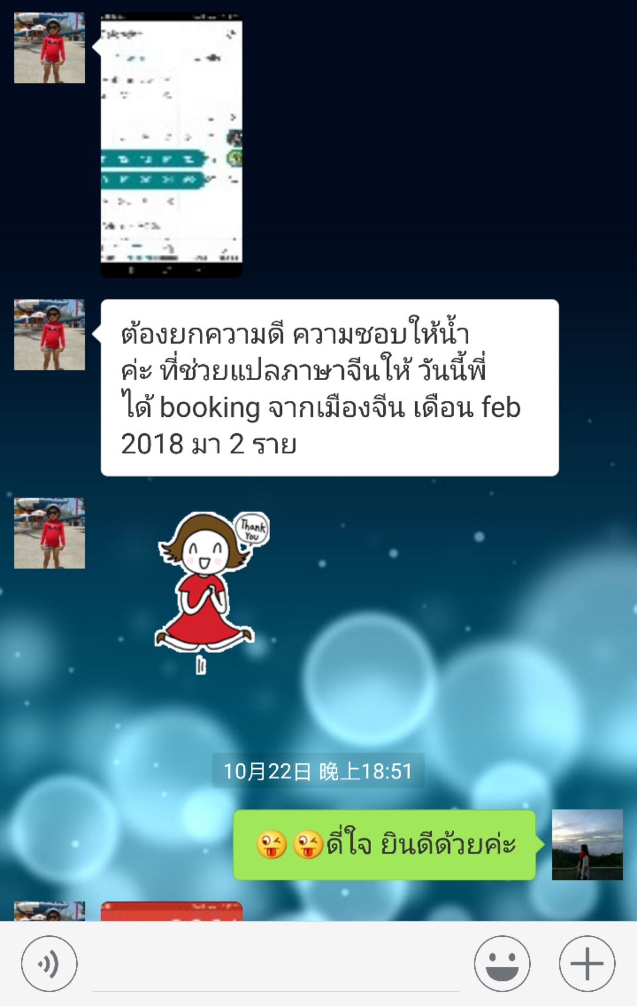
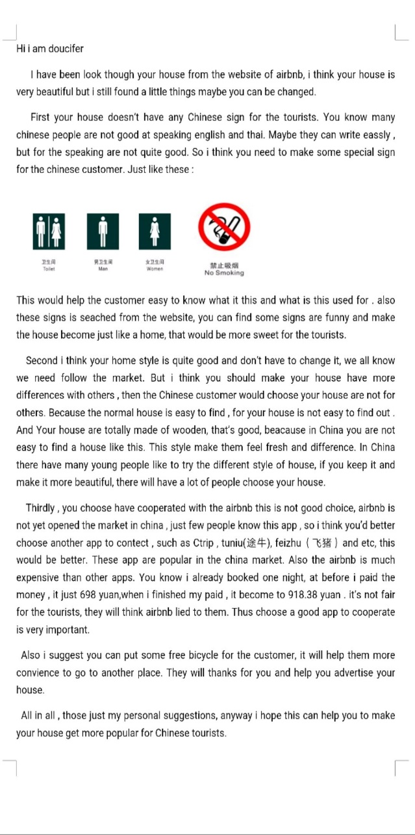
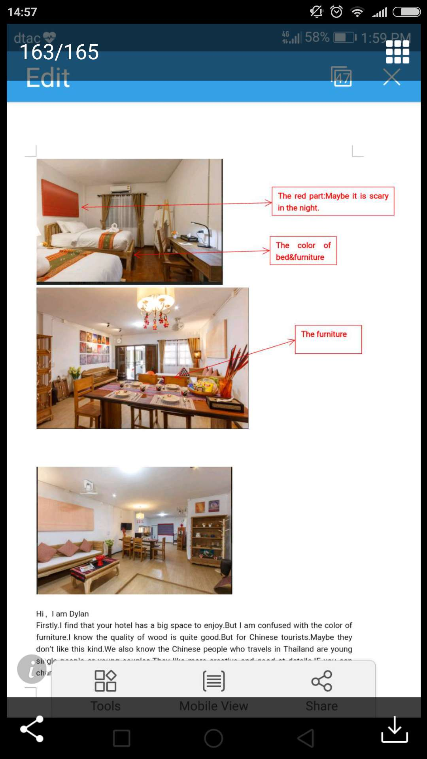
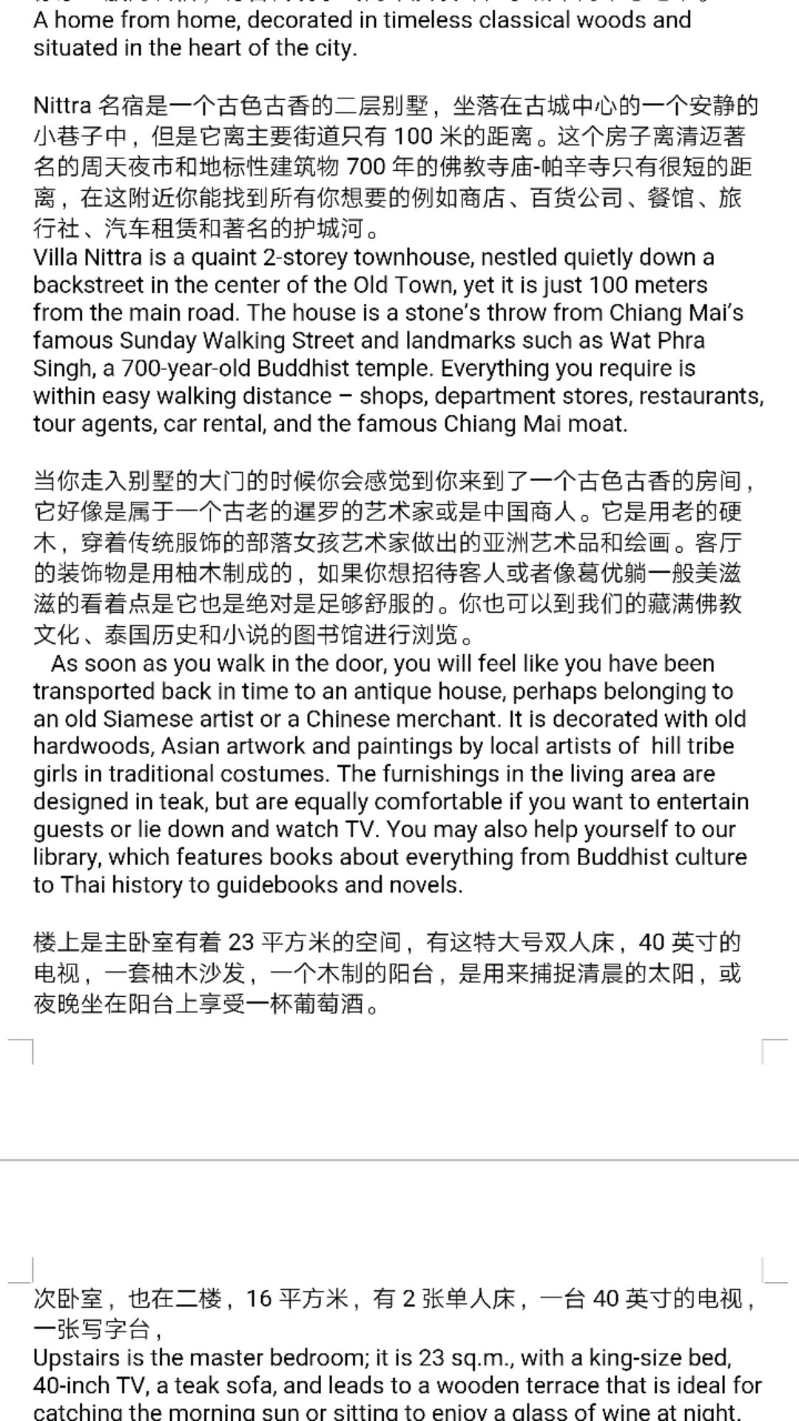
CIC Working achievement
Consultant
Chinese PR content
feedback

Slide 10
CIC 工作成果展
Chinese PR content
feedback

Slide 11
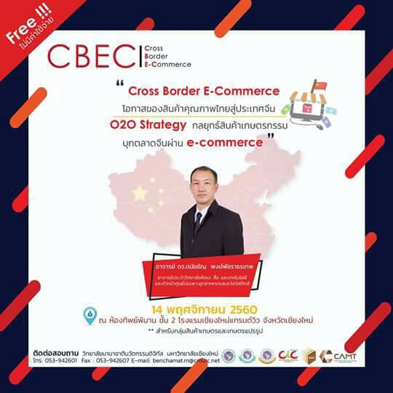
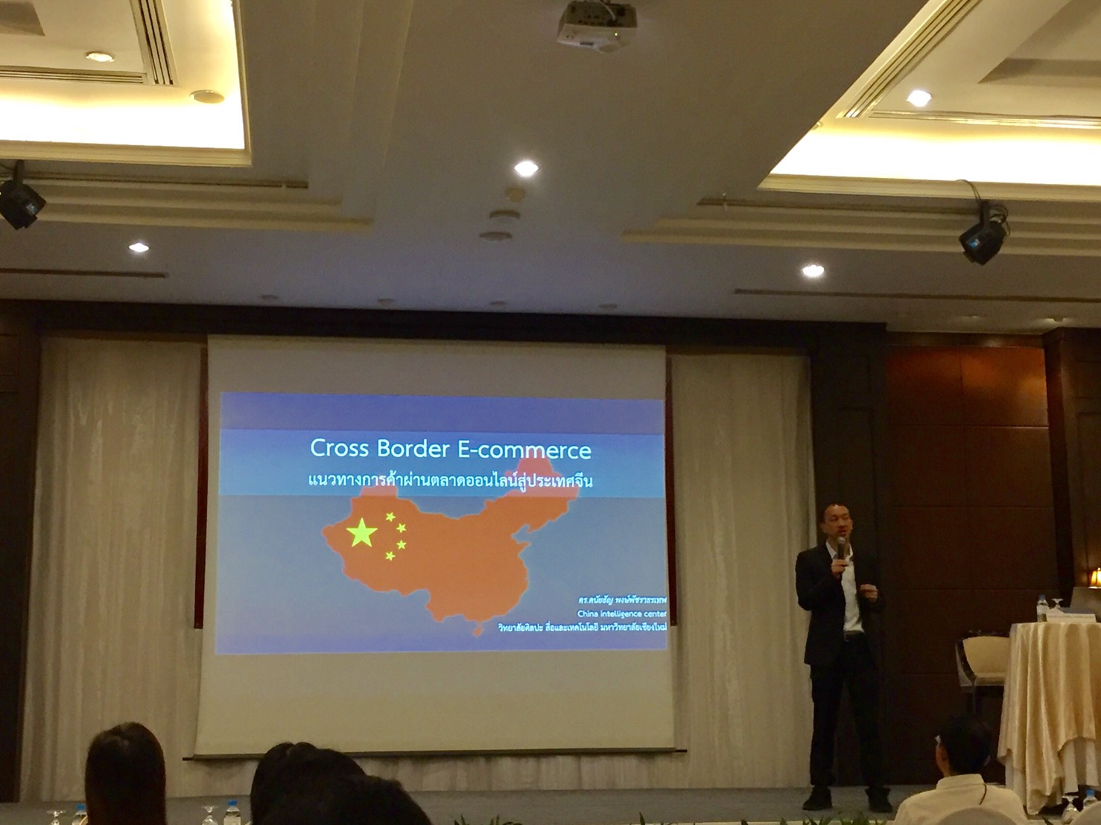
Working achievement

Slide 12
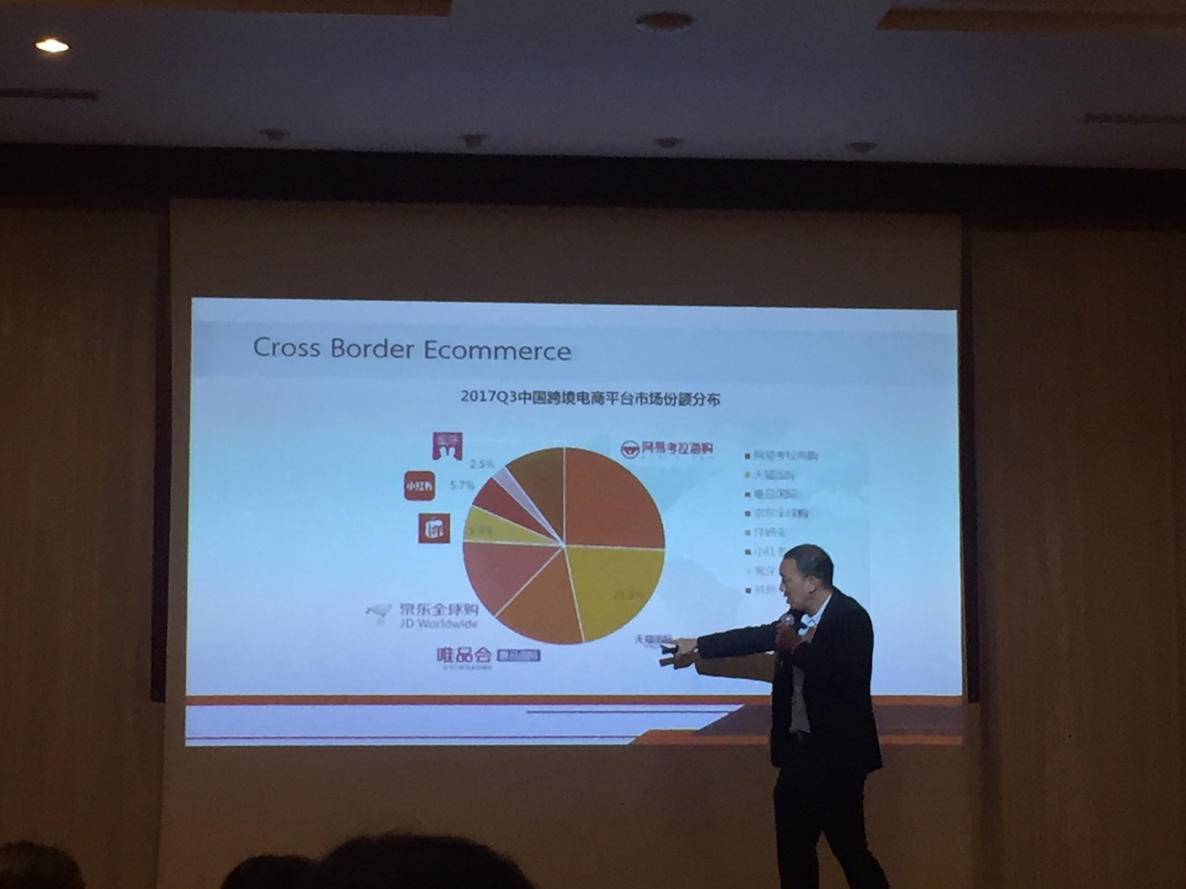
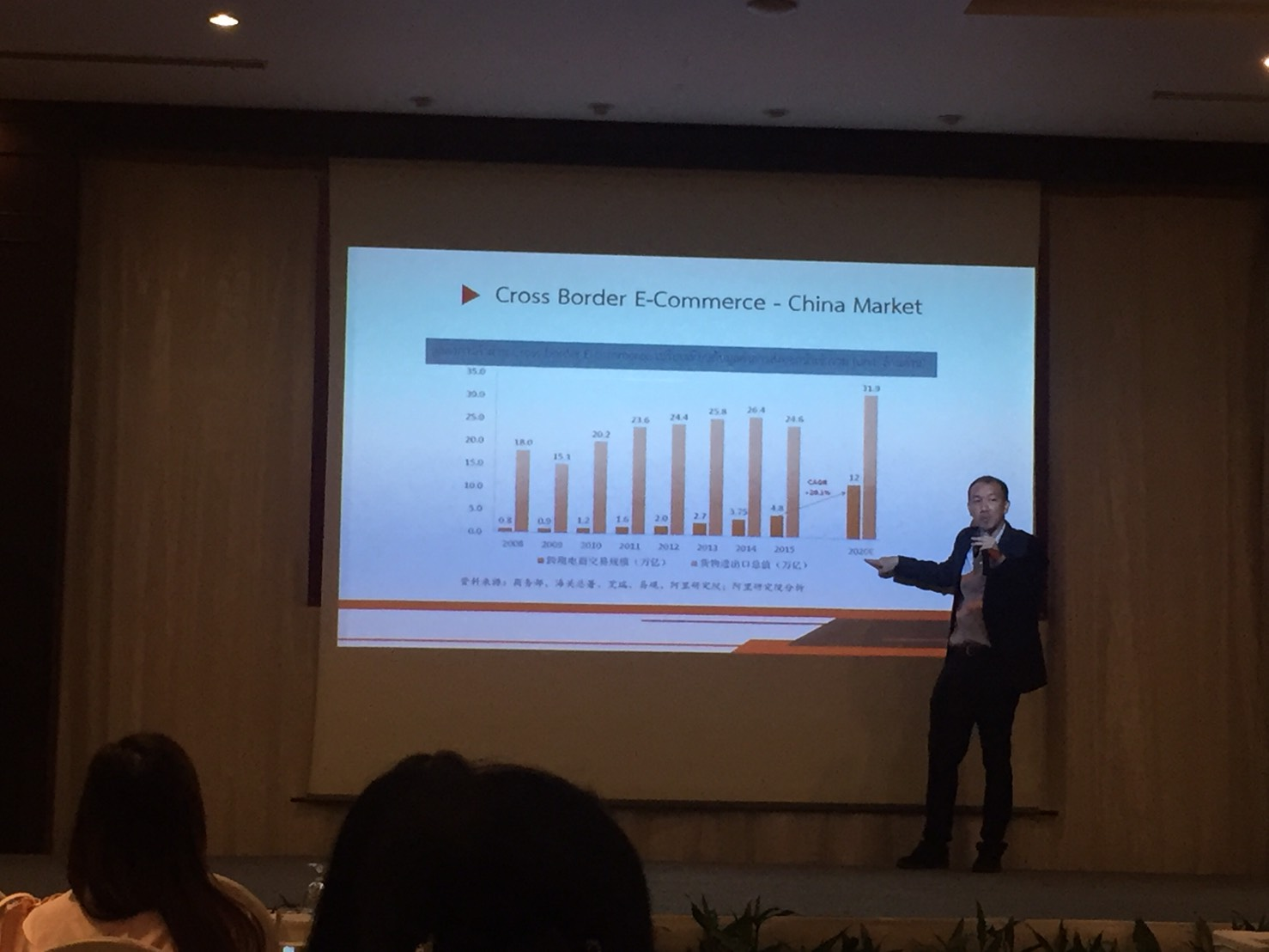
Working achievement

Slide 13
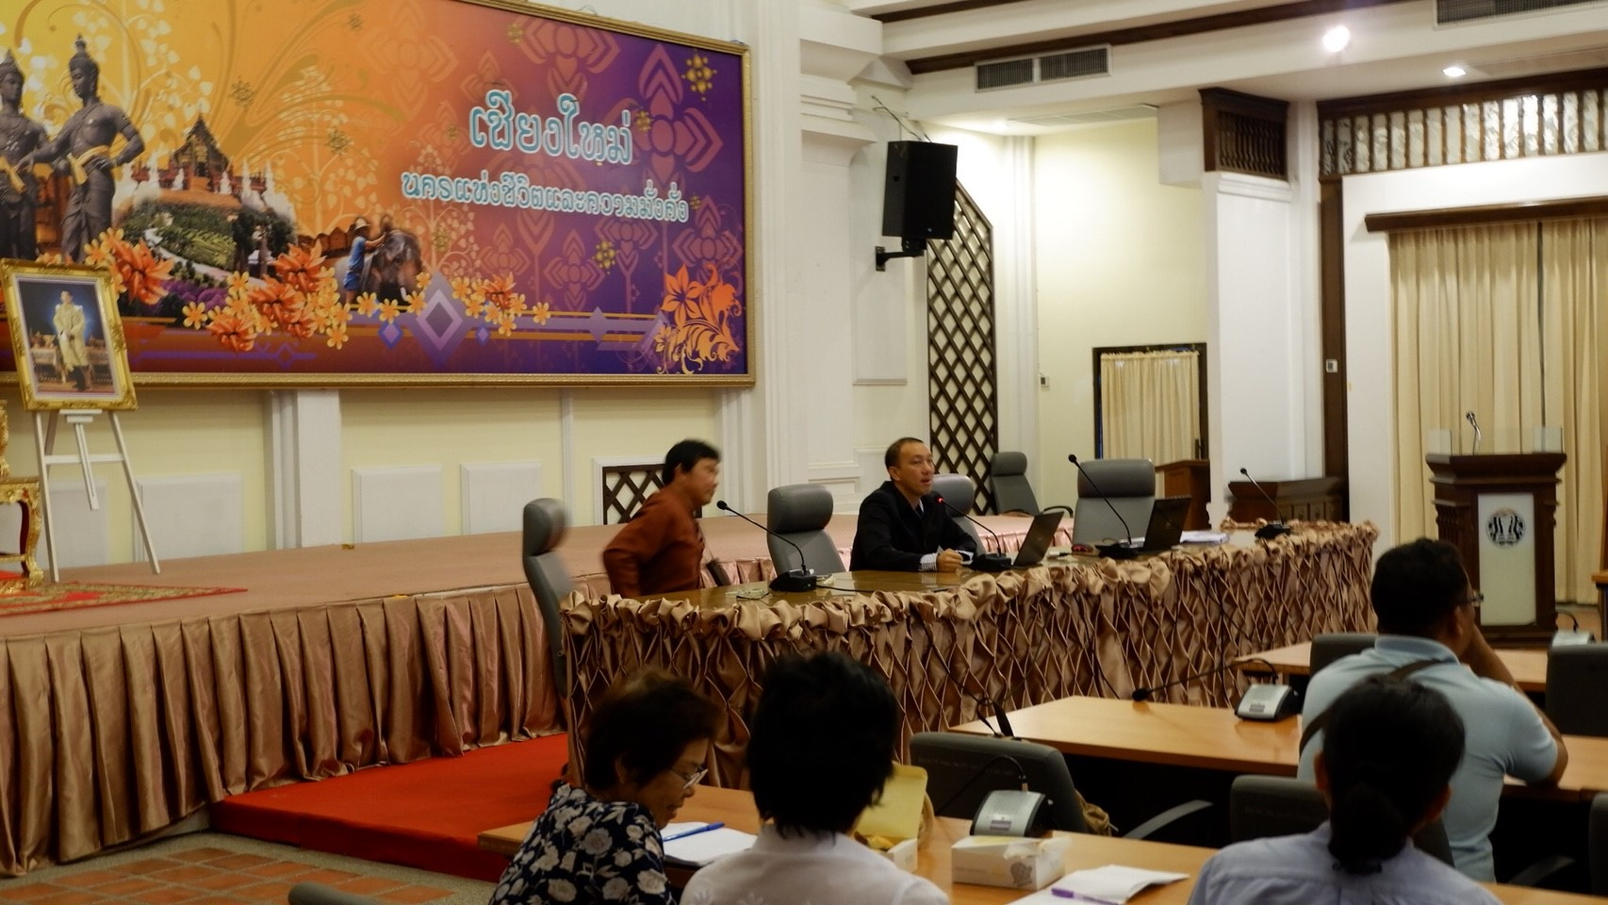
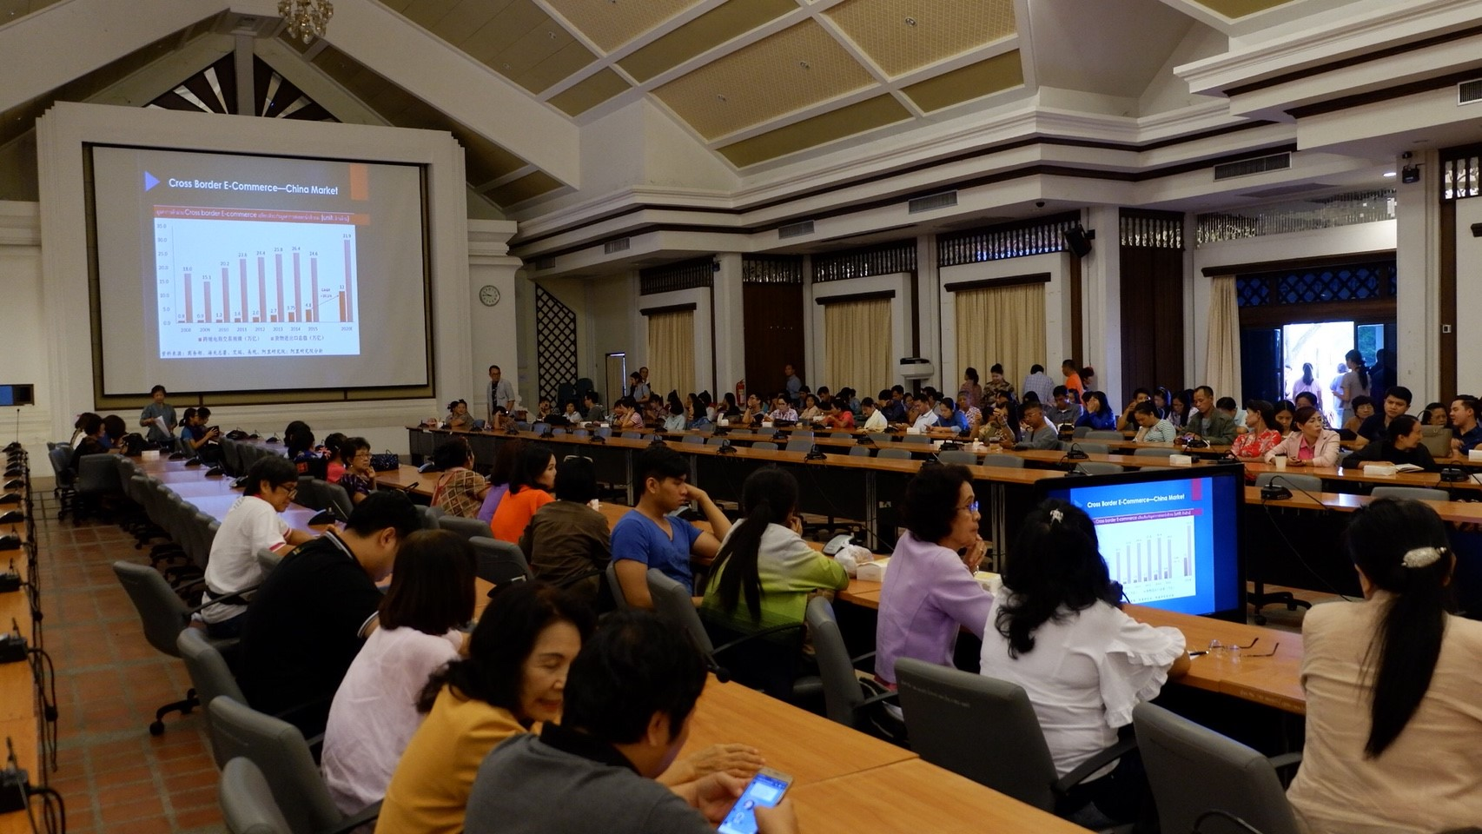
Working achievement

Slide 14
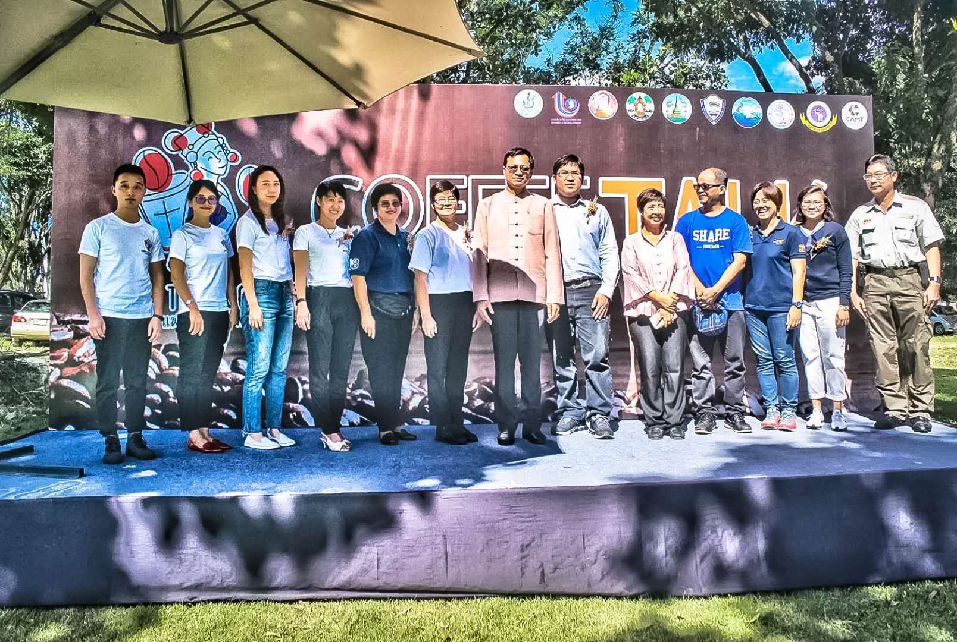
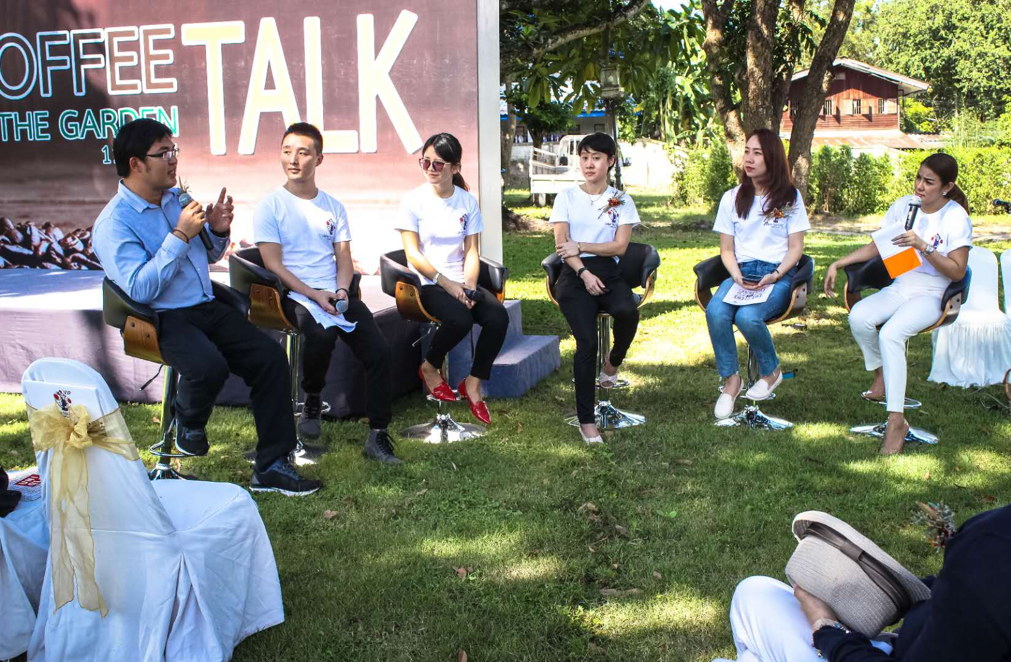
Working achievement

Slide 15
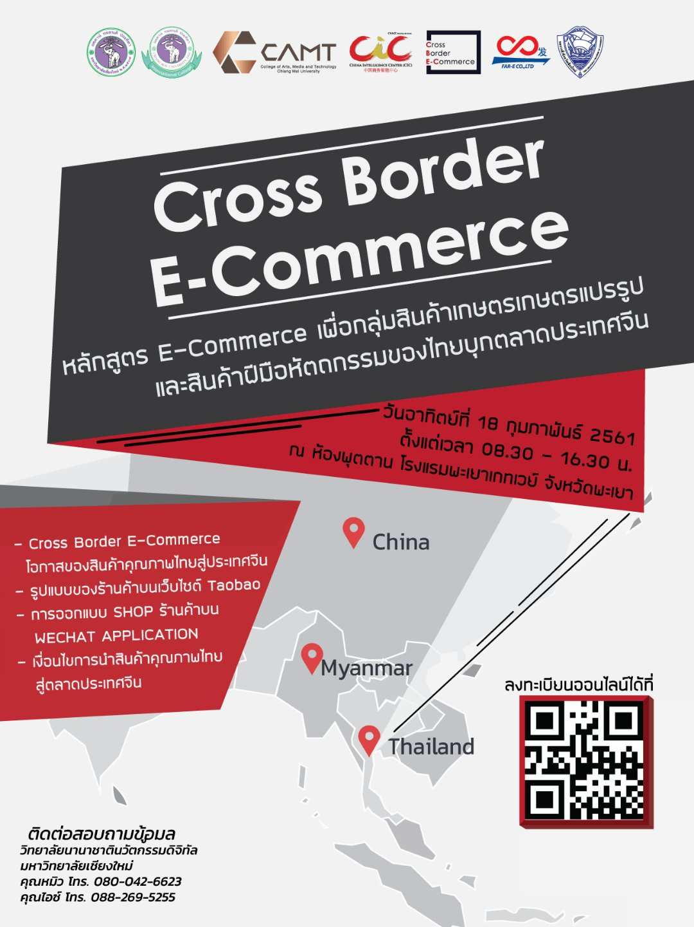
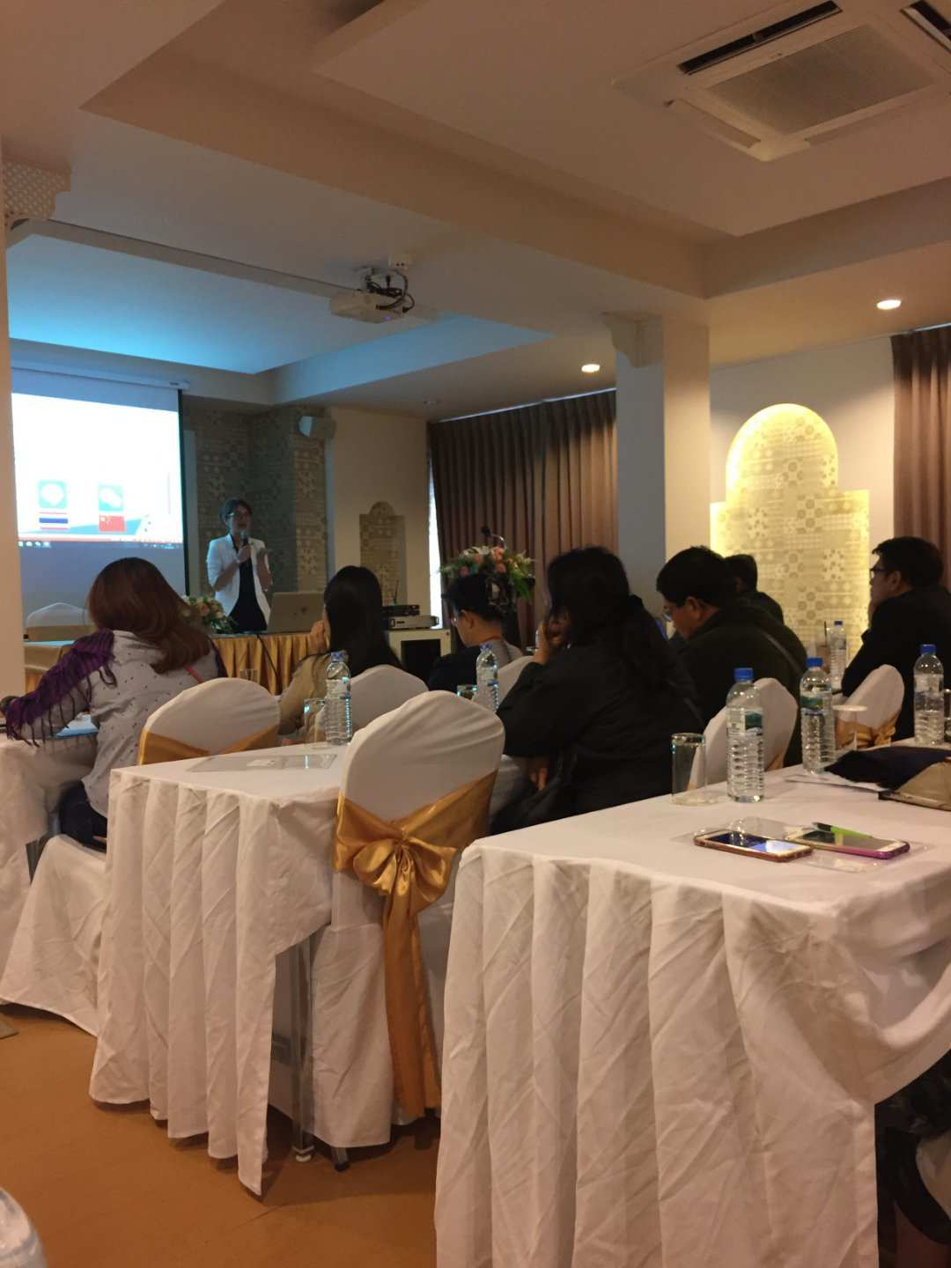
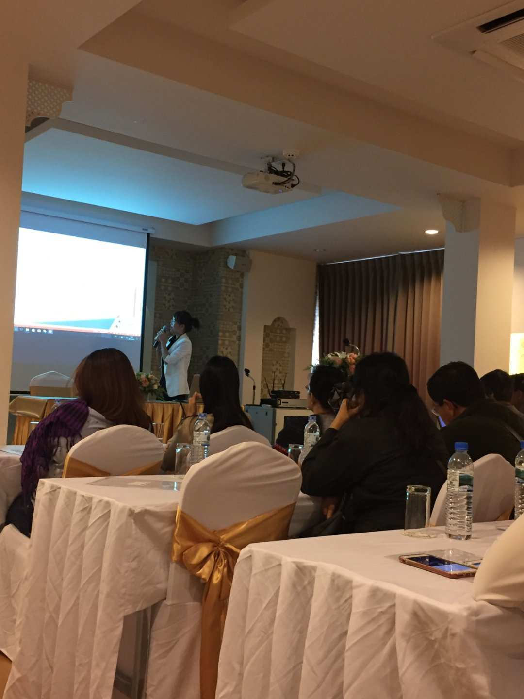
Working achievement

Slide 16
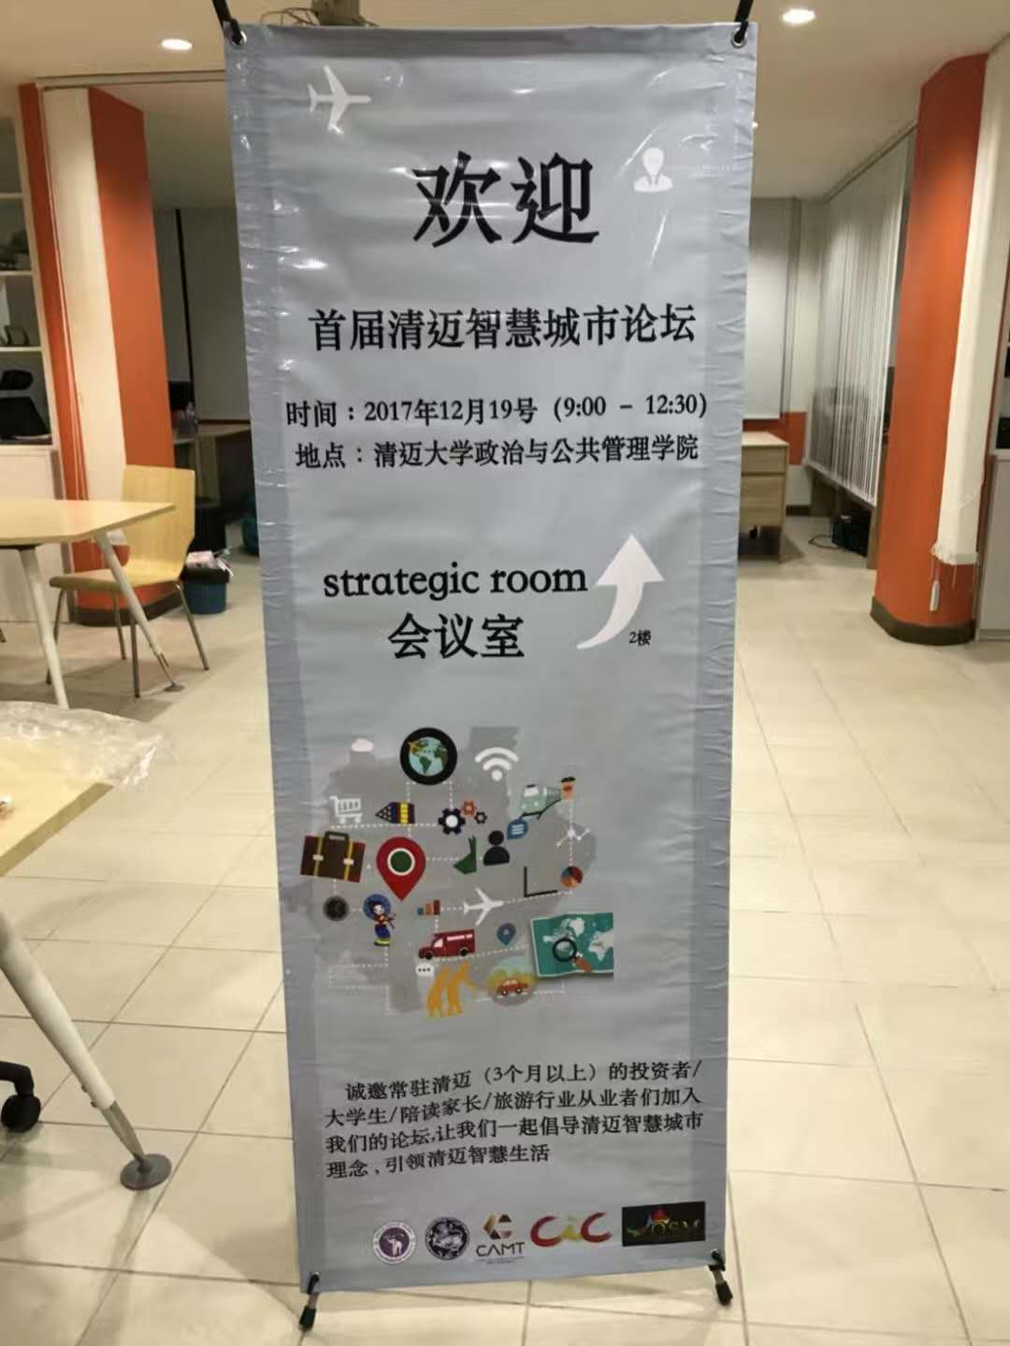
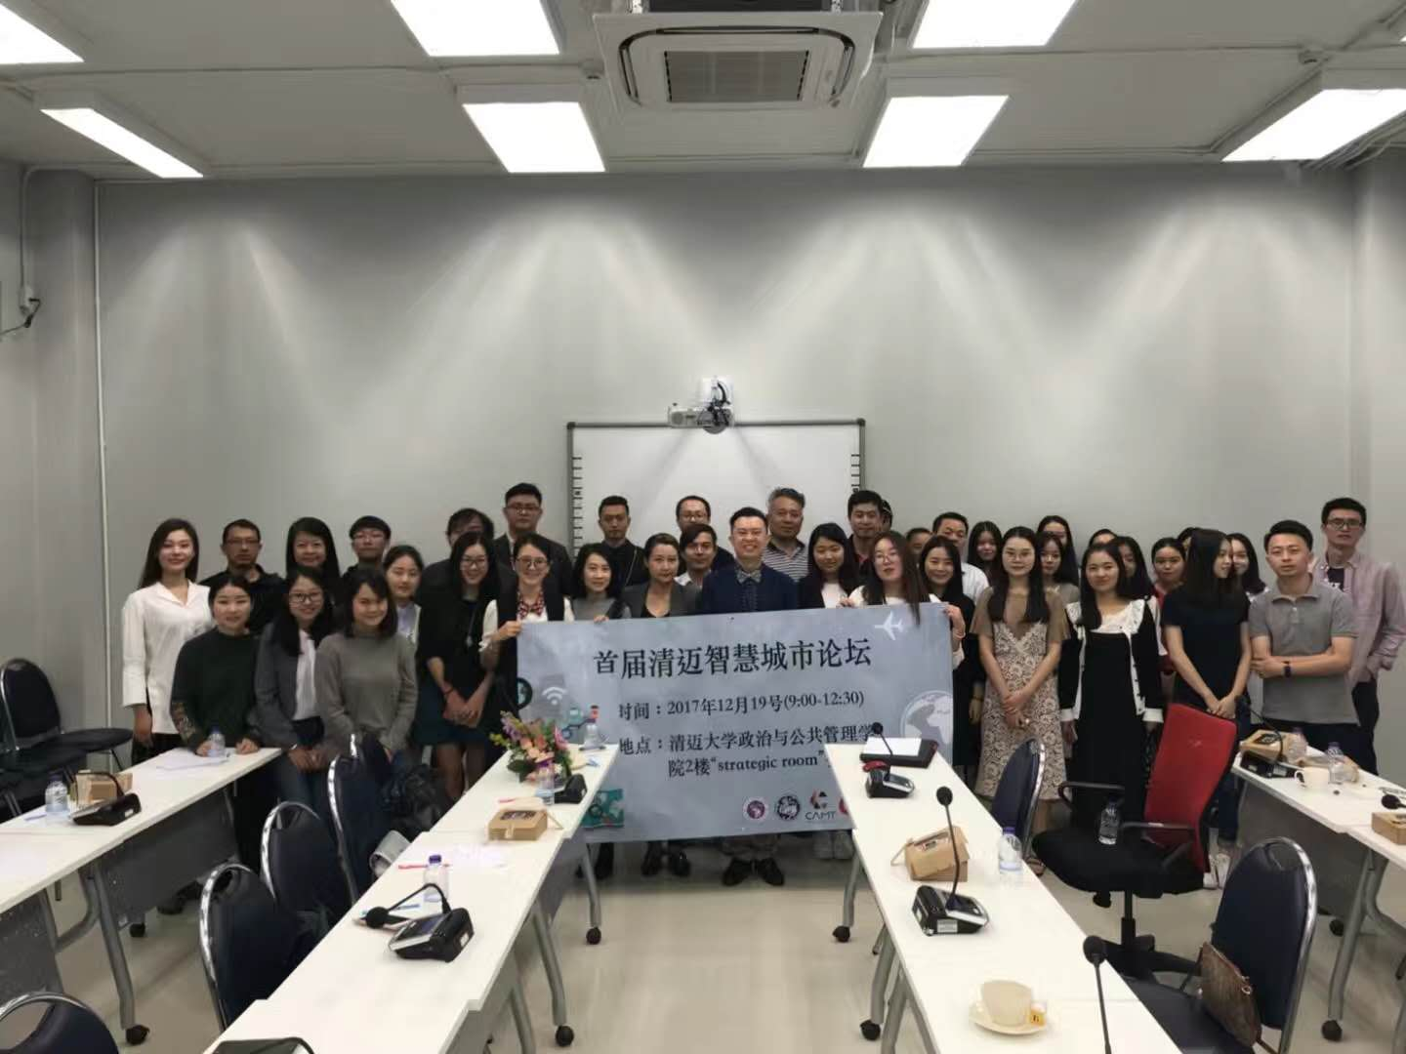
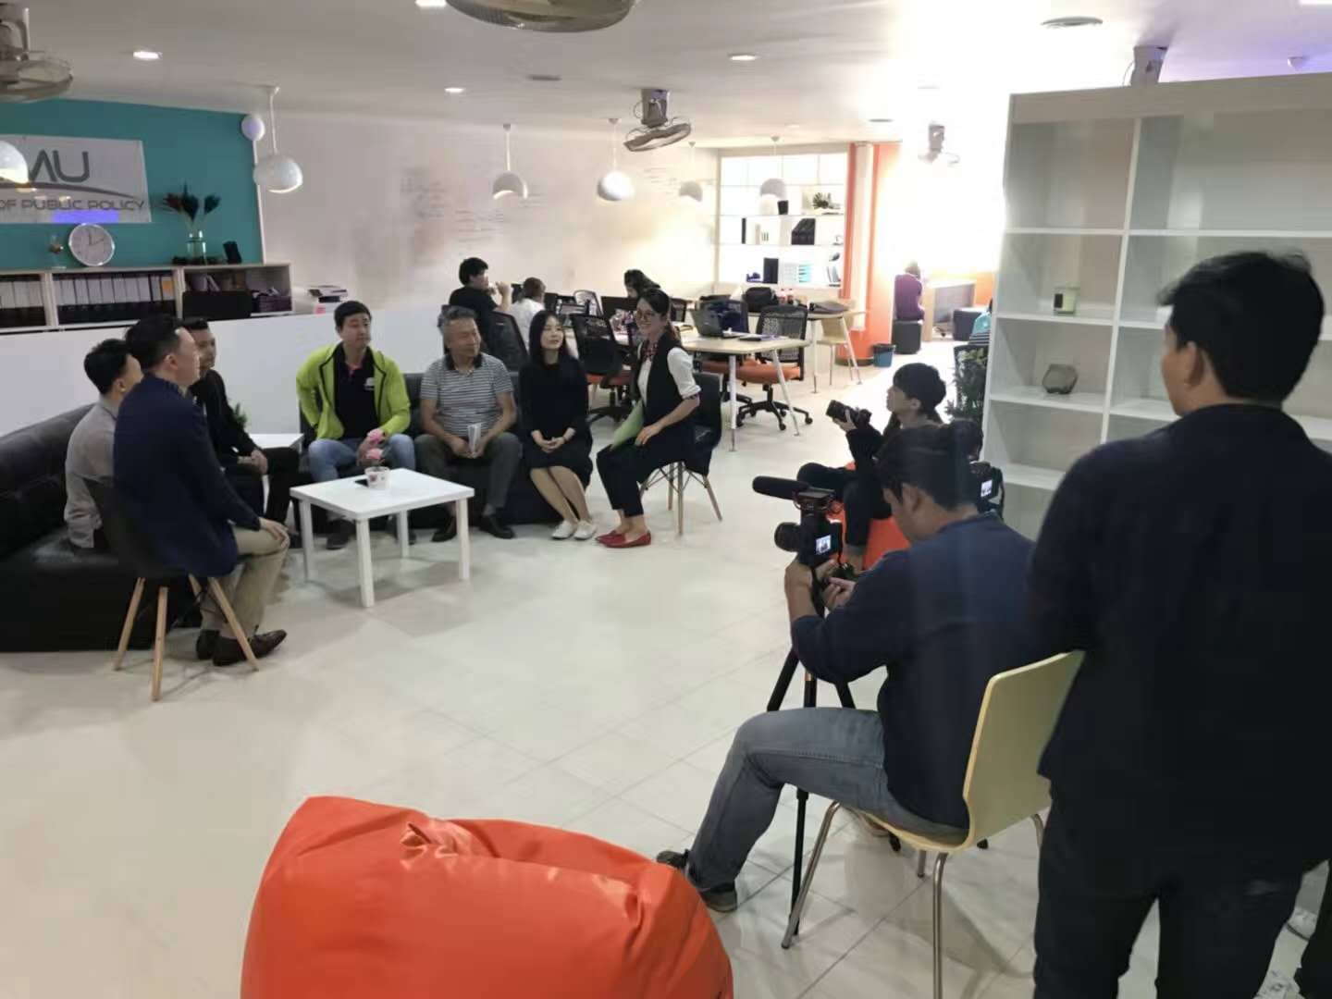
Working achievement

Slide 17
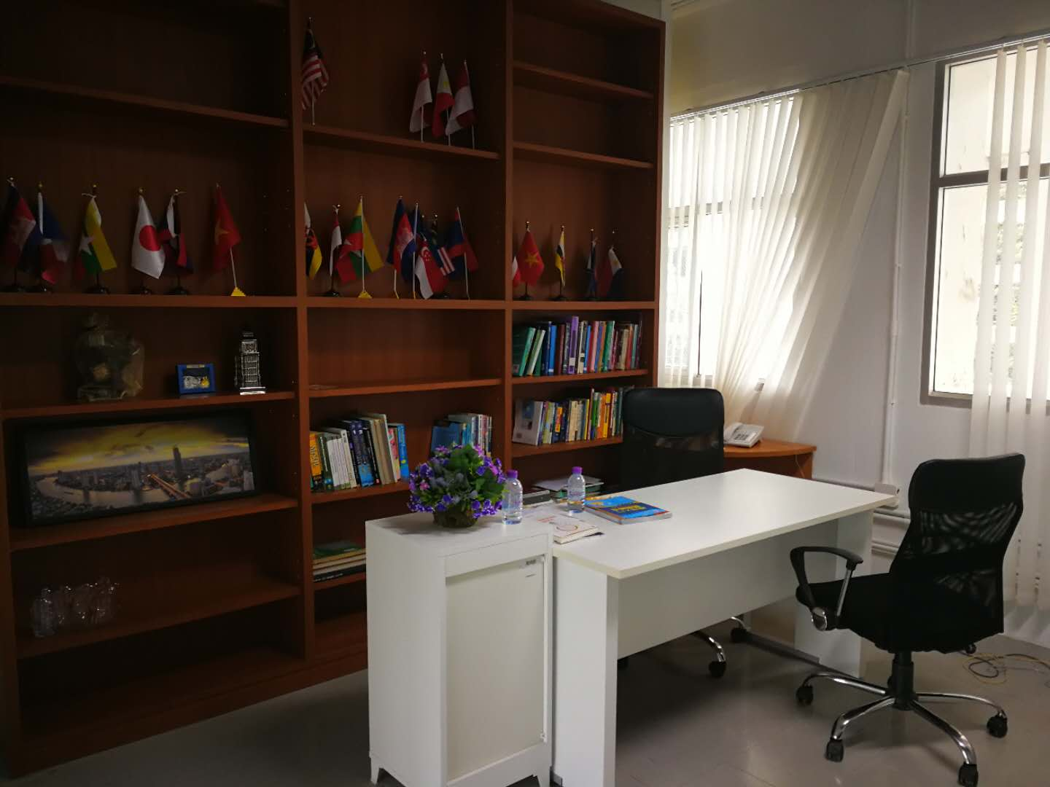
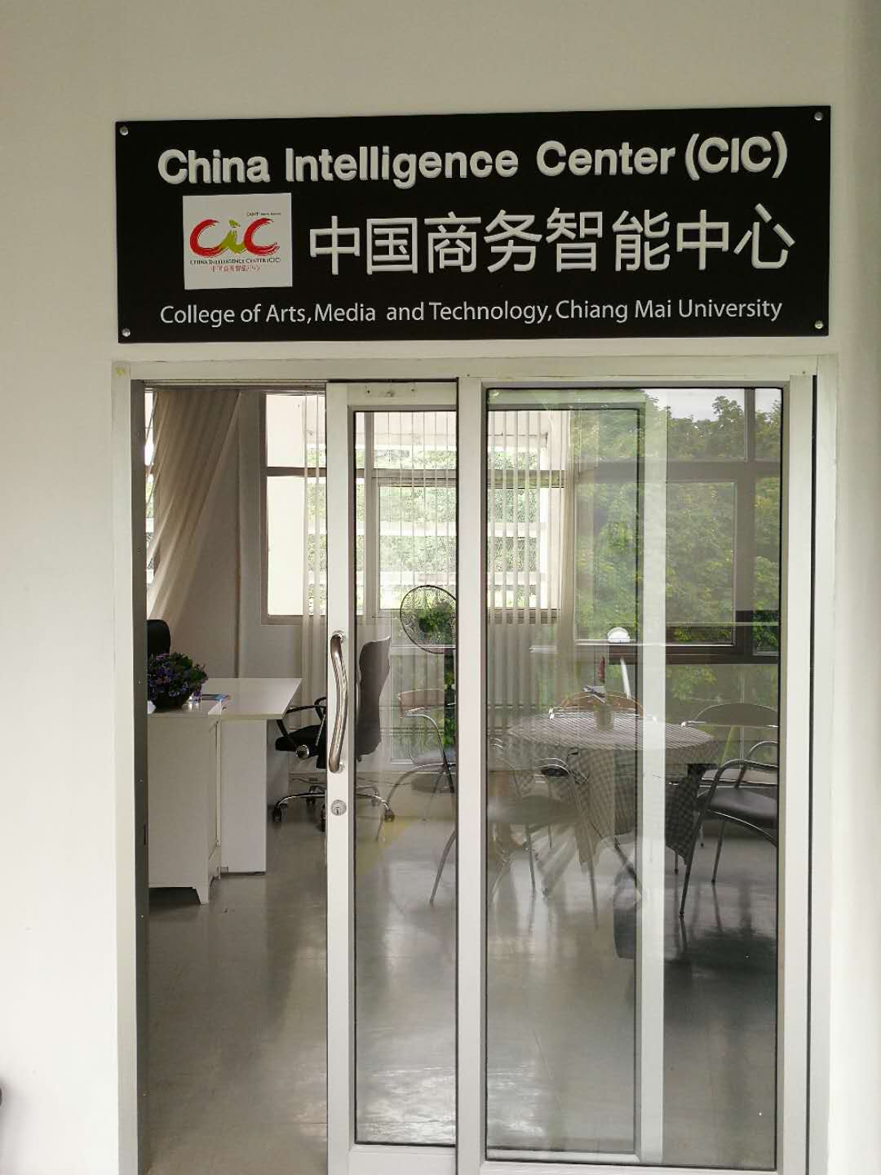
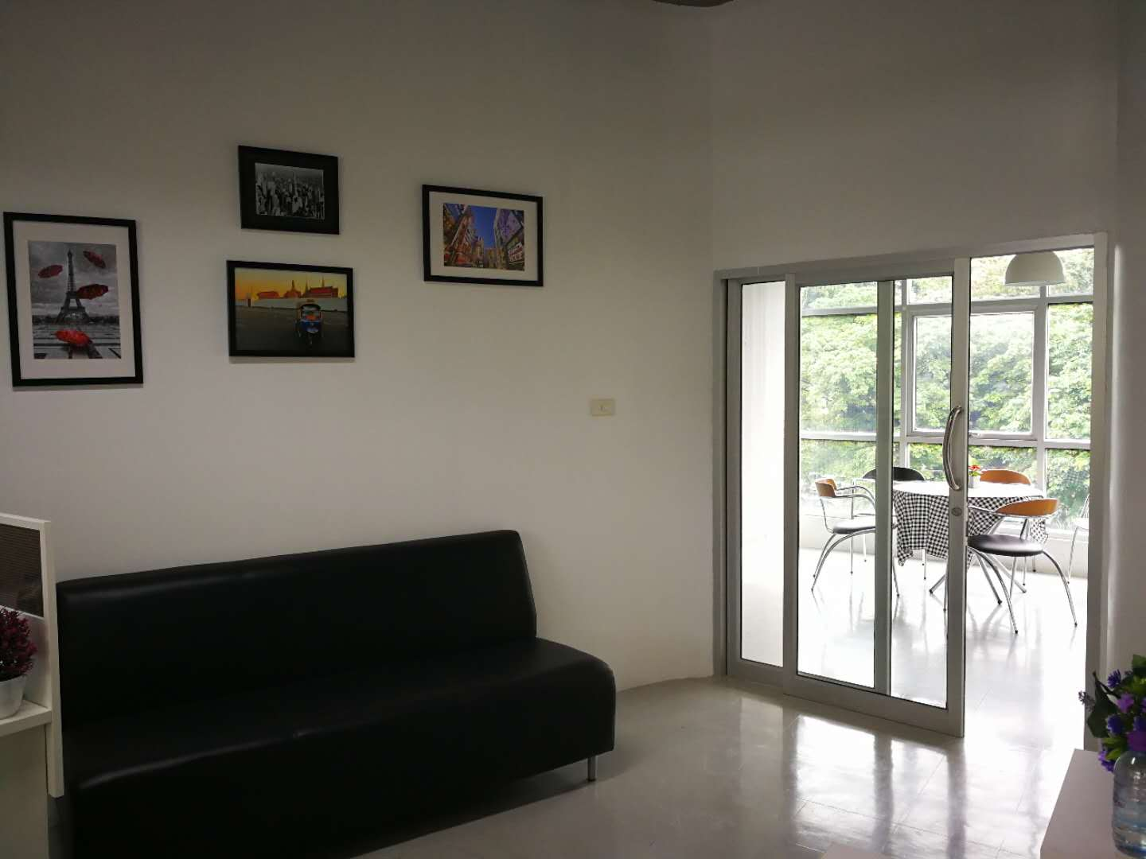
Email:
danaitun.p@cmu.ac.th
MB: 0817466285
qingwei_s@camu.ac.th
MB: 0993720099

Slide 18
China Intelligence Center (CIC)
中国商务智能中心
CAMT
053-920299 ext. 302
Leader: ดร.ดนัยธัญ พงษ์พัชราธรเทพ
Email: danaitun.p@cmu.ac.th
MB: 081-746-6285
Assistant: Qingwei Shen (น้ำ)
Email: shenqingwei@Hotmail.com
MB: 099-372-0099

Slide 19
China Intelligence Center (CIC)
中国商务智能中心
座机电话：053-920299 ext. 302
处长: Danaitun Pongpatcharatorntep 博士
邮箱: danaitun.p@cmu.ac.th
电话: 081-746-6285
助理: Qingwei Shen (น้ำ)
邮箱: shenqingwei@Hotmail.com
电话: 099-372-0099

Slide 20
Online Marketing Based on Social Media
DING JIANWEI
College of Arts,Media and Technology.Chiang Mai University

Slide 21
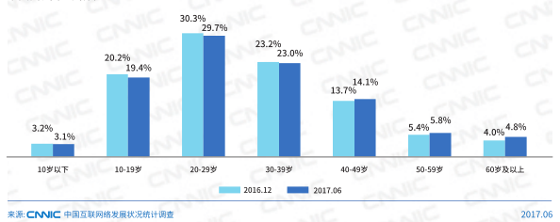
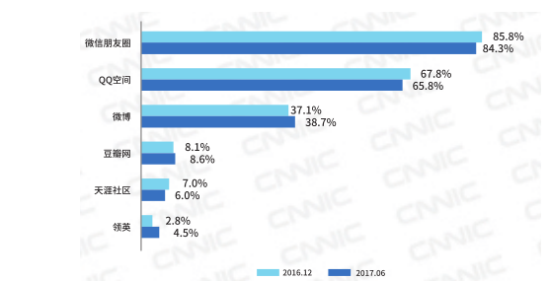
Why we choose social media ?
In June 2017, China's netizens reached 751 million,and China's mobile phone users reached 724 million.
Top 3
More 50% netizens:20-39 years old
Top 3 are social media app.(Social media covers most chinese netizens)
Source:China Internet Network Information Center

Slide 22
Cheaper and Effeciency than Other Channels
For small and middle companies,They cannot afford to do advertisements frequently on TV.
We can easily get data and feedback from social media.
We can focus on our consumer objectives easily.(The Chinese toursits are young people,like collect travel information from social media)
We can get more reputation from social media.
More and more big brands also regard social media as an important channel for their promotion.

Slide 23
Net idol in Social Media
Net idol economy(Wang Hong Economy)-In social media,gathered popularity, targeted marketing relying on a large group of fans, fans will be transformed into purchasing power.Maybe similar with fan economy.
Net idols share their lifestyle and value to attract many followers.Then net idols spend much time interacting with their followers.After getting famous,They rely on their fame to establish a new type of money-spinning business of their own.

Slide 24
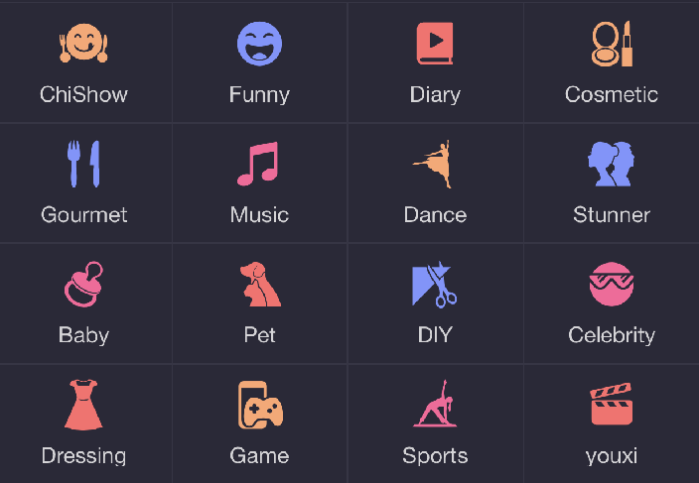
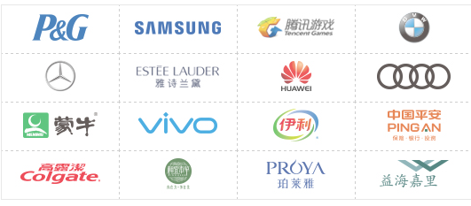
The classfication of Net idol
They start to care about social media and net idols

Slide 25
How can net idols advertise for different industry?
Advertisement for Service
Hotel,Entertainment(like Massage)
Advertisement for products
Gourment,Cosmetic

Slide 26


How to connect Online Marketing with Social media in China?
The Sample:Advertisements for products
How?
(Online Marketing)
(Social media app called Meipai with more 170 million users)

Slide 27
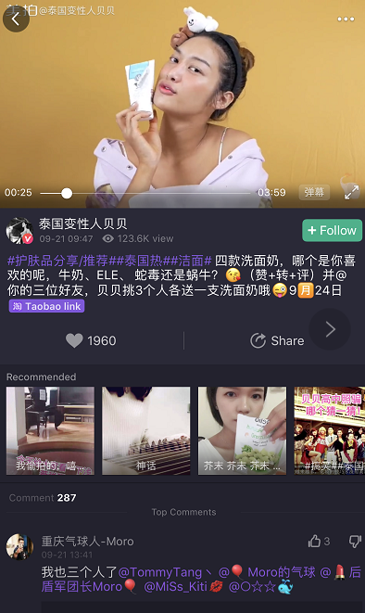
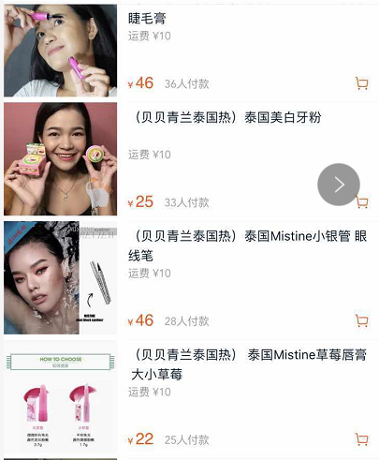
How to sell thailand products in chinese social media? (The example is about real product- thailand cosmetic)
Beauty Buffet
Sold 36 pieces
More 120,000 views
Sold 33 pieces
Taobao link
Sold 28 pieces
1960 likes
Sold 25 pieces
287 comments
Her TaoBao Shop:A part of

Slide 28
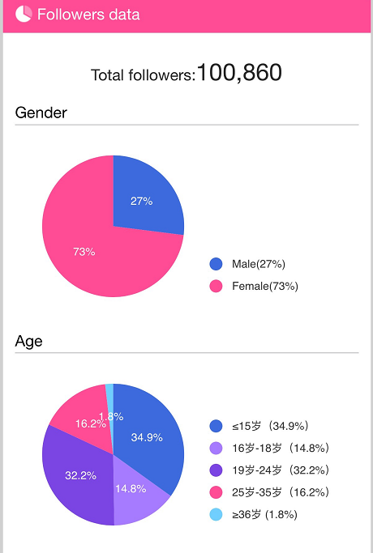
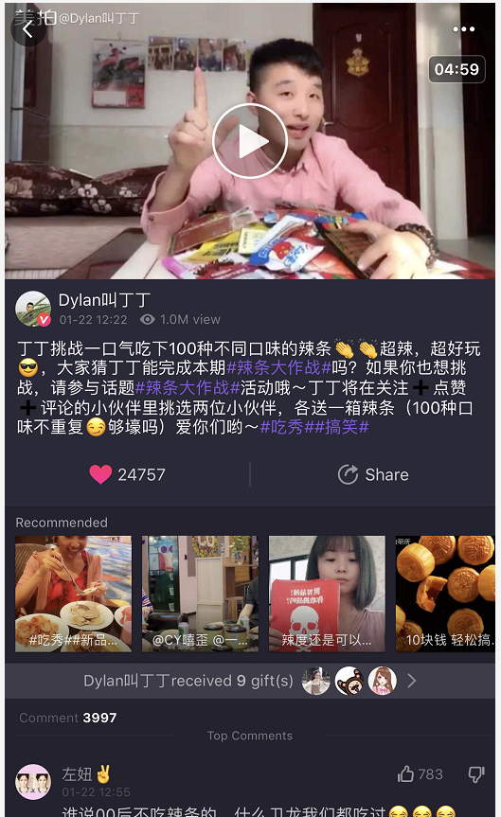
This is a creative advertisements for snacks
1 Million Views
About 25 thousand likes
About 4 thousand comments

Slide 29
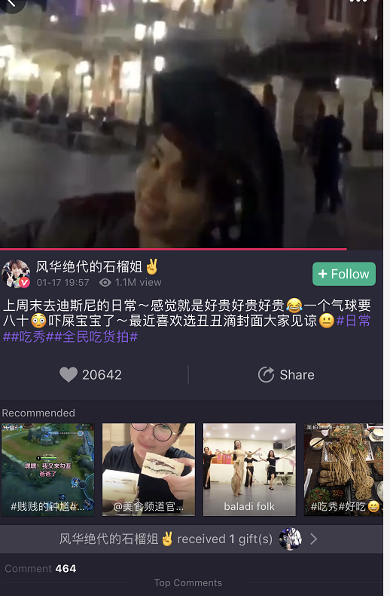
The Sample:Advertisements for Service
The Shanghai Disney Land invites some net idol to experience their service
1.1 Milion Views
More 20 thousand likes
464 comments

Slide 30
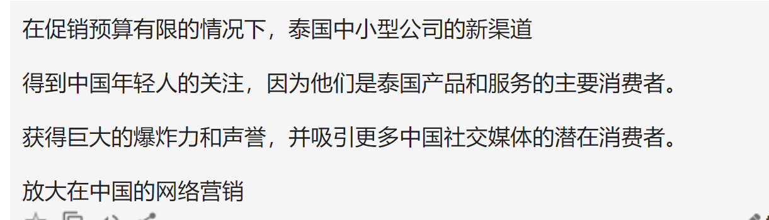
Conclusion
A new channel for thailand small and middle companies when promotional budget is limited
Get much concerns from chinese young people because they are the main consumer for thailand product and service.
Get much explosion and reputation and attract more potential consumer in Chinese social media.
Enlarge Online Marketing in China

Slide 31
Thank you

